Slide 1
Krishi.AI
Theme:
AI for Sustainable Agriculture

Slide 2
Team Details
Team Name: Scar
1
1
Shakthi S (Leader)
2
N Karthik
Email:
Phone:
College: JSS Academy of Technical Education
Email:
Phone:
College: JSS Academy of Technical Education
3
Aryan Prasad
4
Bhoomika Subramanya
Email: aryanprasad6aug@gmail.com
Phone: 9380088115
College: JSS Academy of Technical Education
Email: Bhoomikasubramanya3172004@gmail.com
Phone: 8618211639
College: JSS Academy of Technical Education

Slide 3
Problem Statement
Theme: AI for Sustainable Agriculture
Small and marginal farmers in India face fragmented, outdated, and inaccessible agricultural support systems. They struggle to access timely, personalized, and localized guidance for crop planning, pest management, weather forecasting, market prices, and government schemes. Existing digital solutions are either too generic, language-restricted, or lack real-time, actionable insights. Moreover, there’s no continuity of advice across sessions, leading to repetitive information gathering and decision fatigue.
This results in lower productivity, higher risk of crop loss, missed market opportunities, and underutilization of government benefits, keeping farmers trapped in cycles of low income and financial instability.

Slide 4
Our Idea
Krishi.AI is an AI-powered, multilingual agricultural copilot designed to deliver hyperlocal, personalized, and explainable farming guidance to small and marginal farmers. It leverages multi-agent systems—CrewAI for most workflows and LangGraph for advanced crop planning—to process multiple data streams simultaneously. Real-time inputs from weather APIs, soil health data, market price trackers, and government databases enable the system to provide accurate and timely recommendations. Short-term context is managed by LangChain, while Mem0 powers long-term memory, ensuring continuity of advice across seasons. This intelligent architecture allows Krishi.AI to adapt to each farmer’s specific needs, land conditions, and historical farming patterns.
Accessible via mobile app, website, and Telegram bot, Krishi.AI offers voice-first regional language support for inclusivity and offline capabilities for low-connectivity regions. Farmers can use it for advanced crop planning (considering weather forecasts, soil health, and profit optimization), pest and disease detection via image or symptom input, mandi price tracking, and tailored government scheme recommendations. The platform’s modular design supports future expansion into IoT integration, crop insurance, and credit scoring. By combining cutting-edge AI, real-time data, and intuitive user experience, Krishi.AI transforms fragmented agricultural information into actionable insights—empowering farmers to make climate-smart, profitable, and sustainable farming decisions.

Slide 5
Features of Krishi.AI
Multi-agent AI architecture – CrewAI for general workflows, LangGraph for advanced crop planning.
Real-time data integration – Weather APIs, market price feeds, soil health reports, and government databases.
Advanced crop planning – Multi-LLM analysis considering weather, soil, profitability, and rotation strategies.
Short-term memory – Session context retention via LangChain.
Long-term memory – Personalized recommendations powered by Mem0.
Pest & disease detection – Image-based and symptom-based diagnostics.
Mandi price tracker – Live commodity pricing and market trend analysis.
Government scheme advisor – Location and profile-based scheme suggestions.
Voice-first regional language support – Accessible to low-literacy farmers.
Cross-platform access – Mobile app, website, and Telegram bot.
Visual dashboards – Easy-to-read weather, pricing, and planning insights.
Scalable modular design – Future expansion into IoT, crop insurance, and credit scoring.

Slide 6
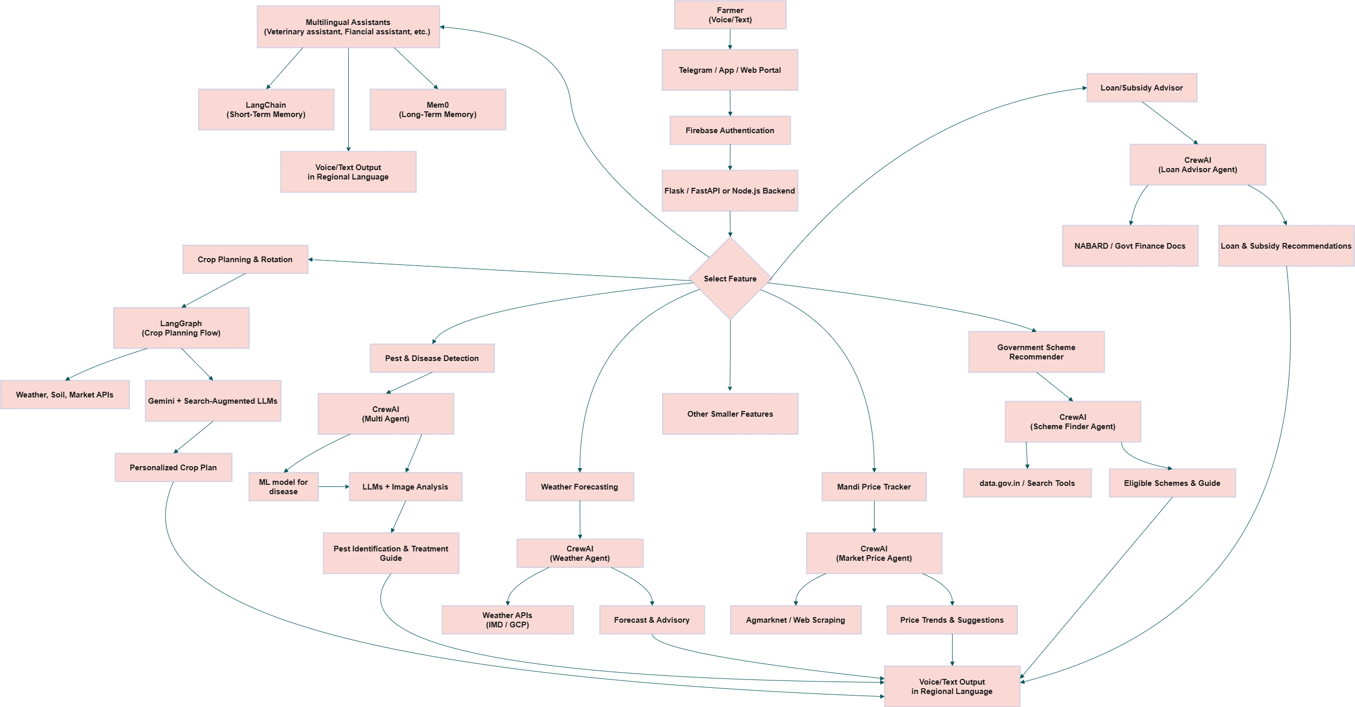
Flowchart of Krishi.AI

